Slide 1
Course overview, principles, MapReduce
CS 240: Computing Systems and Concurrency
Lecture 1
Marco Canini
Credits: Michael Freedman and Kyle Jamieson developed much of the original material. Parts adapted from CMU 15-440.

Slide 2
Backrub (Google) 1997

Slide 3
Google 2012

Slide 4
“The Cloud” is not amorphous

Slide 5
Microsoft

Slide 6
Google

Slide 7
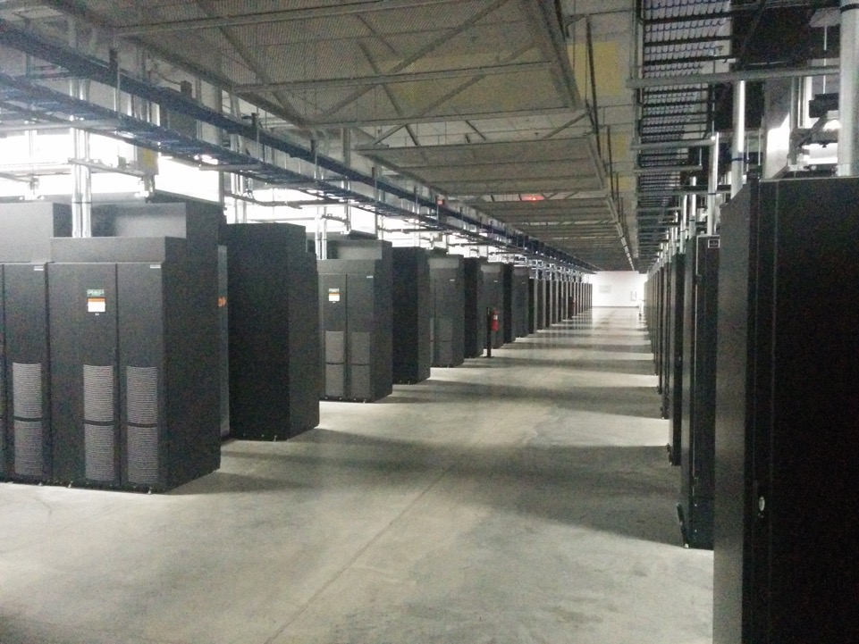
Facebook

Slide 8
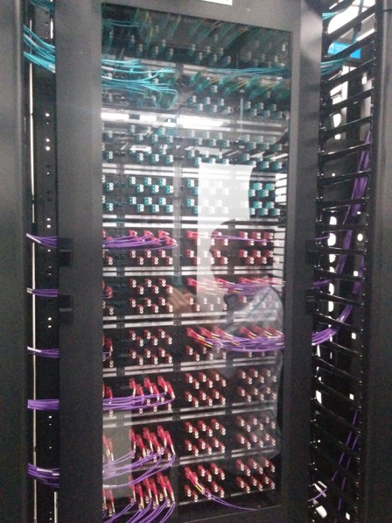
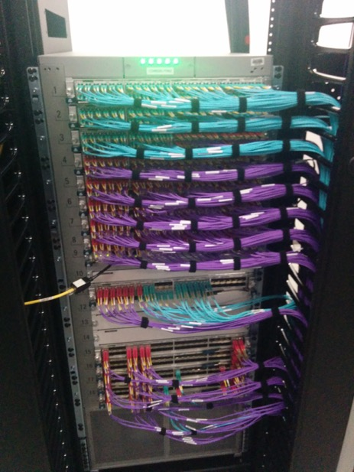

Slide 9
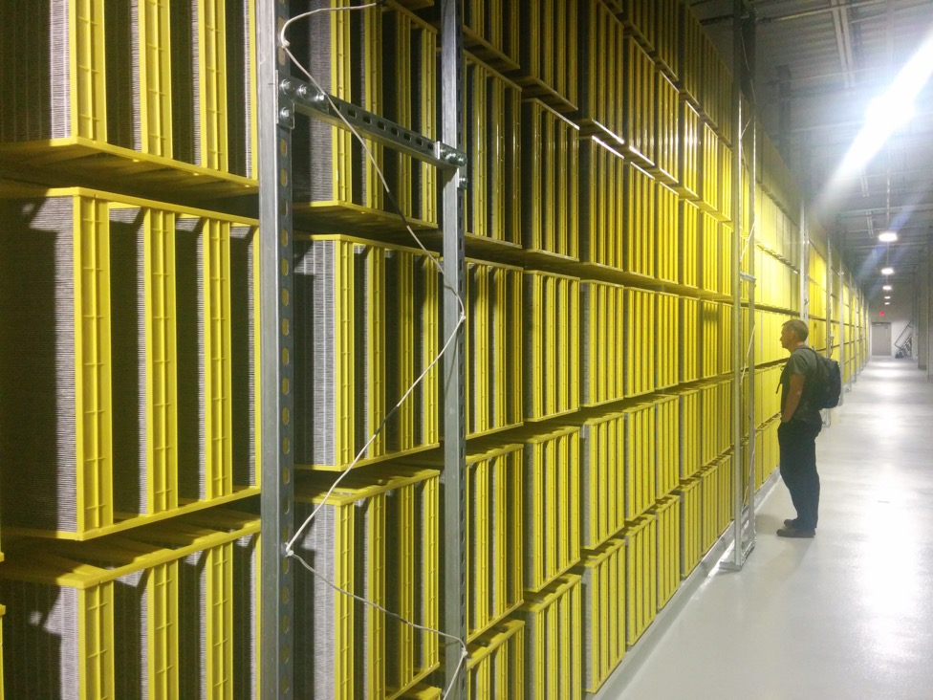

Slide 10

100,000s of physical servers
10s MW energy consumption
Facebook Prineville:
$250M physical infra, $1B IT infra

Slide 11
Everything changes at scale
“Pods provide 7.68Tbps to backplane”

Slide 12
The goal of “distributed systems”
Service with higher-level abstractions/interface
e.g., file system, database, key-value store, programming model, RESTful web service, …
Hide complexity
Scalable (scale-out)
Reliable (fault-tolerant)
Well-defined semantics (consistent)
Security
Do “heavy lifting” so app developer doesn’t need to

Slide 13
What is a distributed system?
“A collection of independent computers that appears to its users as a single coherent system”
Features:
No shared memory
Message-based communication
Each runs its own local OS
Heterogeneity
Ideal: to present a single-system image:
The distributed system “looks like” a single computer rather than a collection of separate computers

Slide 14
Distributed system characteristics
To present a single-system image:
Hide internal organization, communication details
Provide uniform interface
Easily expandable
Adding new computers is hidden from users
Continuous availability
Failures in one component can be covered by other components
Supported by middleware

Slide 15
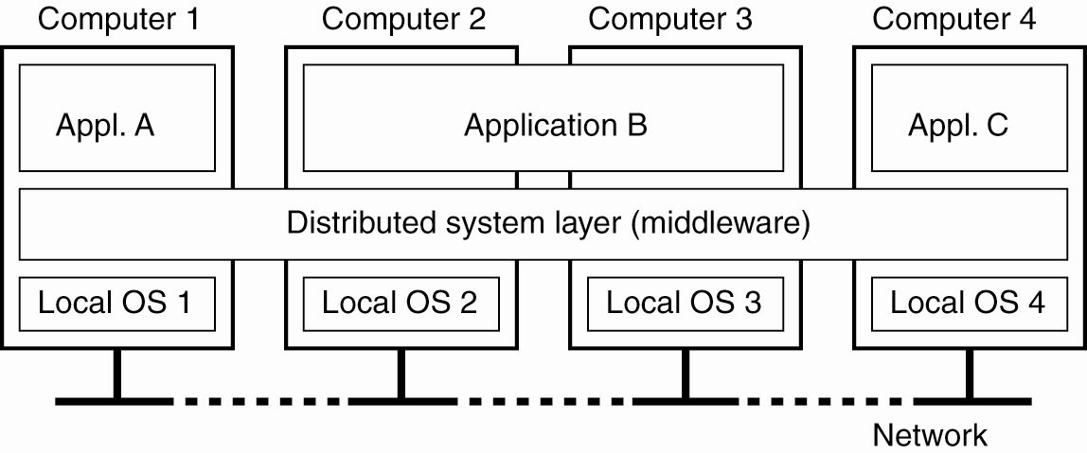
Distributed system as middleware
A distributed system organized as middleware
The middleware layer runs on all machines, and offers a uniform interface to the system
Notes:
What are interesting aspects to note here in the general view of a DS as opposed to a traditional OS?
Applications can now span multiple physical machines.
Applications (single App A/C or distributed App B) are all presented with the same uniform interface by the middleware
The Middleware itself can run on heterogeneous hardware and local OSes -- So, Local OS1 can be Linux, while OS2 can be windows – all possible once the DS middleware is ported to these OS’s.

Slide 16
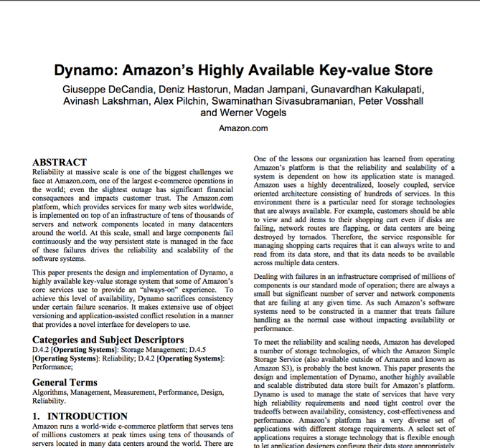
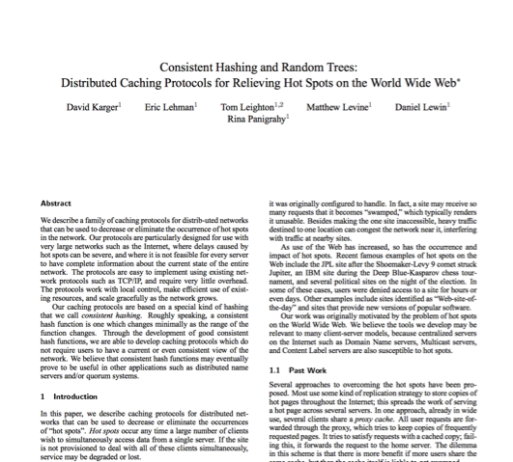
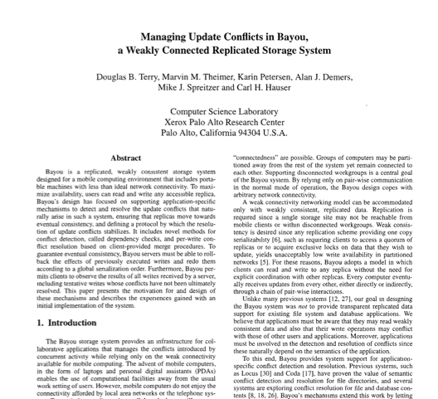
Research results matter: NoSQL
Notes:
NoSQL:
Consistent hash tables
+ consistency tradeoffs (e.g., eventual)
Amazon Dynamo popularized (published SOSP 2007), CTO was faculty at Cornell on distributed systems

Slide 17
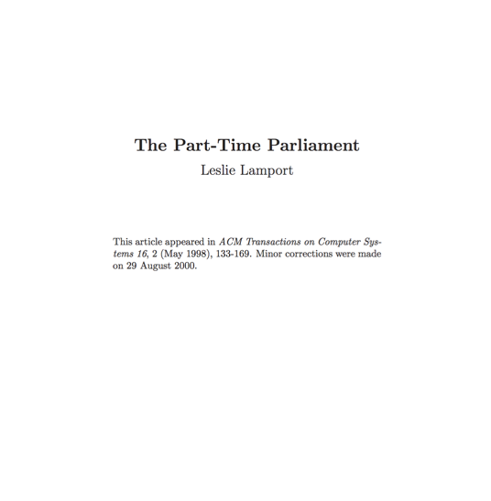
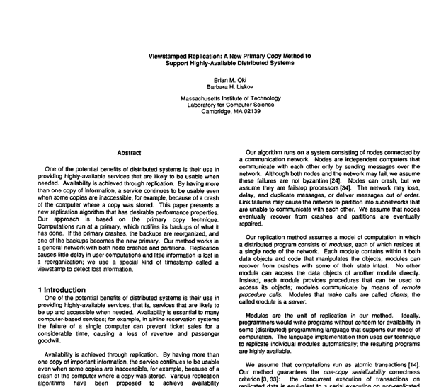
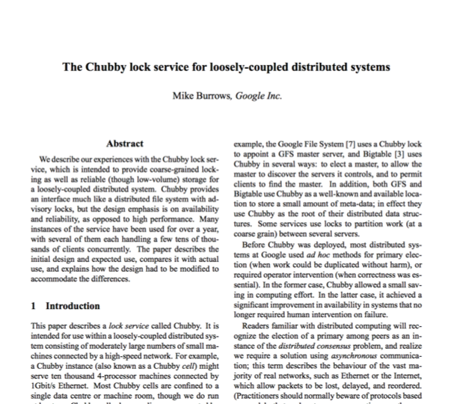
Research results matter: Paxos
Notes:
Paxos
Long history starting in early 1990s on “reaching consensus in distributed systems”
Google Chubby
Coordinate datacenters at scale
When a file server fails, who takes over?
Authors for industrial research labs and academia (DEC SRC, Cambridge/UW, etc.)
Led to open-source Apache Zookeeper

Slide 18
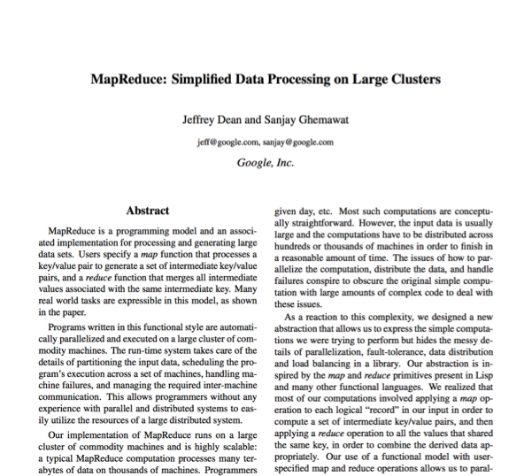

Research results matter: MapReduce
Notes:
Google MapReduce
How to process large volumes of data over 1000s of servers, even in face of failures
Authors for industrial research labs and academia (DEC WRL, MIT/UW, etc.)
Led to open-source Apache Hadoop
Created Big Data industry…

Slide 19
Course Organization

Slide 20
Course Goals
Gain an understanding of the principles and techniques behind the design of modern, reliable, and high-performance systems
In particular learn about distributed systems
Learn general systems principles (modularity, layering, naming, security, ...)
Practice implementing real, larger systems that must run in nasty environment
One consequence: Must pass exams and projects independently as well as in total
Note, if you fail either you will not pass the class

Slide 21
Learning the material: People
Lecture
Professor Marco Canini
Slides available on course website
Office hours immediately after lecture
TAs
Hassan Alsibyani
Humam Alwassel
Main Q&A forum: www.piazza.com
No anonymous posts or questions
Can send private messages to instructors

Slide 22
Learning the Material: Books
Lecture notes!
No required textbooks
References available in the Library:
Programming reference:
The Go Programming Language. Alan Donovan and Brian Kernighan
Topic reference:
Distributed Systems: Principles and Paradigms. Andrew S. Tanenbaum and Maaten Van Steen
Guide to Reliable Distributed Systems. Kenneth Birman

Slide 23
Grading
Four assignments (50% total)
10% for 1 & 2
15% for 3 & 4
Two exams (50% total)
Midterm exam on October 22 (15%)
Final exam during exam period (35%)

Slide 24
About Projects
Systems programming somewhat different from what you might have done before
Low-level (C / Go)
Often designed to run indefinitely (error handling must be rock solid)
Must be secure - horrible environment
Concurrency
Interfaces specified by documented protocols
TAs’ Office Hours
Dave Andersen’s “Software Engineering for System Hackers”
Practical techniques designed to save you time & pain

Slide 25
Where is Go used?
Google, of course!
Docker (container management)
CloudFlare (Content delivery Network)
Digital Ocean (Virtual Machine hosting)
Dropbox (Cloud storage/file sharing)
… and many more!

Slide 26
Why use Go?
Easy concurrency w/ goroutines (lightweight threads)
Garbage collection and memory safety
Libraries provide easy RPC
Channels for communication between goroutines

Slide 27
Collaboration
Working together important
Discuss course material
Work on problem debugging
Parts must be your own work
Midterm, final, solo projects
Team projects: both students should understand entire project
What we hate to say: we run cheat checkers…
Please *do not* put code on *public* repositories
Partner problems: Please address them early

Slide 28
Policies: Write Your Own Code
Programming is an individual creative process. At first, discussions with friends is fine. When writing code, however, the program must be your own work.
Do not copy another person’s programs, comments, README description, or any part of submitted assignment. This includes character-by-character transliteration but also derivative works. Cannot use another’s code, etc. even while “citing” them.
Writing code for use by another or using another’s code is academic fraud in context of coursework.
Do not publish your code e.g., on Github, during/after course!

Slide 29
Late Work
72 late hours to use throughout the semester
(but not beyond December 6)
After that, each additional day late will incur a 10% lateness penalty
(1 min late counts as 1 day late)
Submissions late by 3 days or more will no longer be accepted
(Fri and Sat count as days)
In case of illness or extraordinary circumstance (e.g., emergency), talk to us early!

Slide 30
Assignment 1
Learn how to program in Go
Implement “sequential” MapReduce
Instructions on assignment web page
Due September 20, 23:59

Slide 31
Case Study: MapReduce
(Data-parallel programming at scale)

Slide 32
Application: Word Count
SELECT count(word) FROM data
GROUP BY word
cat data.txt
| tr -s '[[:punct:][:space:]]' '\n'
| sort | uniq -c

Slide 33
Using partial aggregation
Compute word counts from individual files
Then merge intermediate output
Compute word count on merged outputs

Slide 34
Using partial aggregation
In parallel, send to worker:
Compute word counts from individual files
Collect result, wait until all finished
Then merge intermediate output
Compute word count on merged intermediates

Slide 35
MapReduce: Programming Interface
map(key, value) -> list(<k’, v’>)
Apply function to (key, value) pair and produces set of intermediate pairs
reduce(key, list<value>) -> <k’, v’>
Applies aggregation function to values
Outputs result

Slide 36
MapReduce: Programming Interface
map(key, value):
for each word w in value:
EmitIntermediate(w, "1");
reduce(key, list(values):
int result = 0;
for each v in values:
result += ParseInt(v);
Emit(AsString(result));

Slide 37
MapReduce: Optimizations
combine(list<key, value>) -> list<k,v>
Perform partial aggregation on mapper node:
<the, 1>, <the, 1>, <the, 1> → <the, 3>
combine() should be commutative and associative
partition(key, int) -> int
Need to aggregate intermediate vals with same key
Given n partitions, map key to partition 0 ≤ i < n
Typically via hash(key) mod n

Slide 38
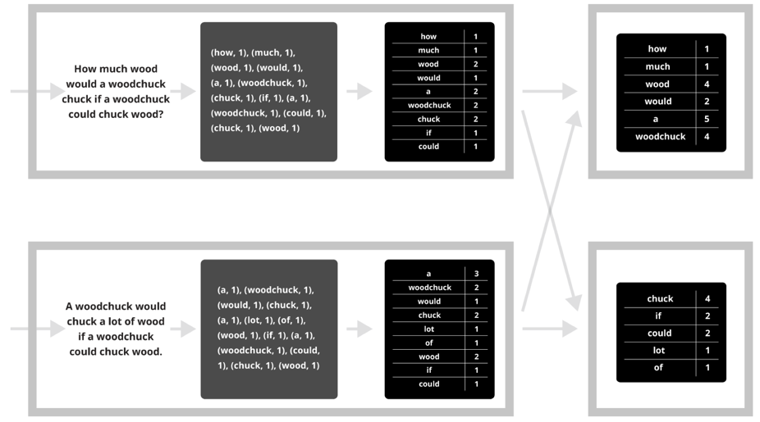
Putting it together…
map
combine
partition
reduce

Slide 39
Synchronization Barrier

Slide 40
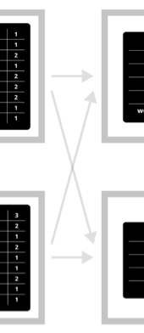
Fault Tolerance in MapReduce
Map worker writes intermediate output to local disk, separated by partitioning. Once completed, tells master node.
Reduce worker told of location of map task outputs, pulls their partition’s data from each mapper, execute function across data
Note:
“All-to-all” shuffle b/w mappers and reducers
Written to disk (“materialized”) b/w each stage

Slide 41
Fault Tolerance in MapReduce
Master node monitors state of system
If master failures, job aborts and client notified
Map worker failure
Both in-progress/completed tasks marked as idle
Reduce workers notified when map task is re-executed on another map worker
Reducer worker failure
In-progress tasks are reset to idle (and re-executed)
Completed tasks had been written to global file system

Slide 42
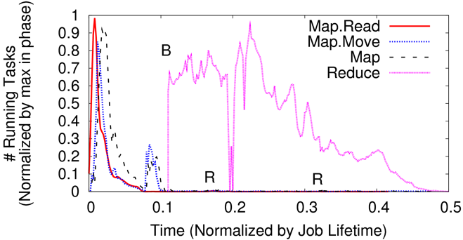
Straggler Mitigation in MapReduce
Tail latency means some workers finish late
For slow map tasks, execute in parallel on second map worker as “backup”, race to complete task

Slide 43
You’ll build (simplified) MapReduce!
Assignment 1: Sequential MapReduce
Learn to program in Go!
Due September 20
Assignment 2: Distributed MapReduce
Learn Go’s concurrency, network I/O, and RPCs
Due October 15

